Slide 1

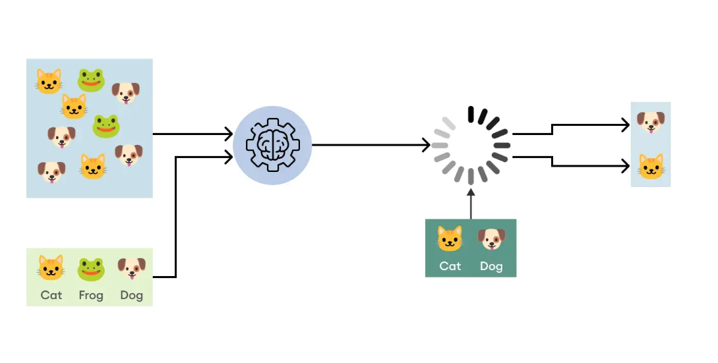
Deep Learning model For Image Classification

Slide 2

Name: Mohd Farman
Data Science Intern
Meta Scifor Technology, MST03-0075
MCA 2023, Galgotias University

Slide 3

Contents
01
About
Short summary about the project, subtitle for the model, task and how it start.
04
Result
Find the performance ,accuracy and evaluation of the model
02
Tools
Discus about tools, software and platform.
05
Conclusion
Final conclusion after test and train the model
03
Methodology
Describe all the methods which are which in this project
06
References
Mention all the sources which help to create this model and give depth knowledge about all the component

Slide 4
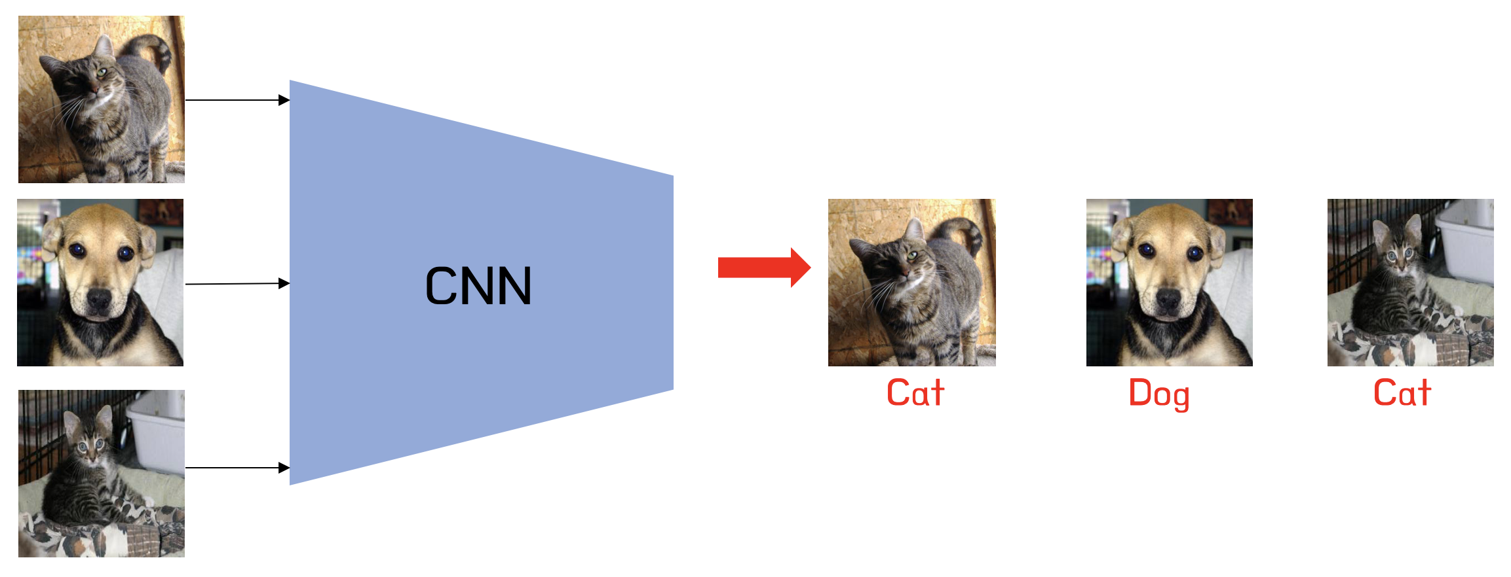
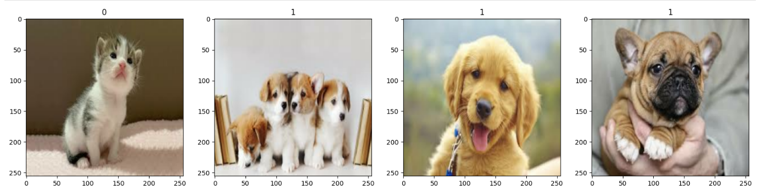
1. About
building a deep learning model for image classification, training the model, evaluating its performance, testing with new data, and saving the trained model for future use. The model is designed to classify images into two categories: kittens and puppies. The document includes code snippets for each step, from data preprocessing to model evaluation and saving.
Task: build a model for puppies and kitten images classification with some labeled data.
Sub title: Kitten vs. Puppy Classification

Slide 5
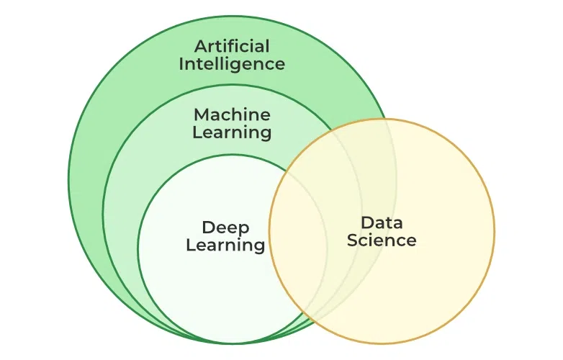
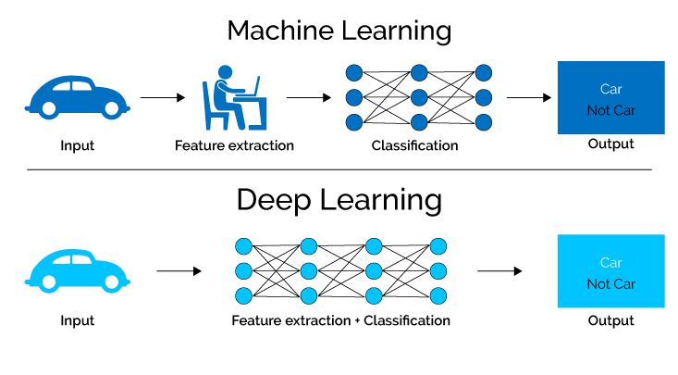
1.2 Deep Learning
Deep learning is a method in artificial intelligence (AI) that teaches computers to process data in a way that is inspired by the human brain. Deep learning models can recognize complex patterns in pictures, text, sounds, and other data to produce accurate insights and predictions. You can use deep learning methods to automate tasks that typically require human intelligence, such as describing images or transcribing a sound file into text.
Deep Learning Applications:
Computer Vision: Object detection and recognition, Image classification and Image segmentation
Natural language processing (NLP): Automatic Text Generation, Language translation, Sentiment analysis and Speech recognition
Reinforcement learning: Game playing, Robotics and control system

Slide 6
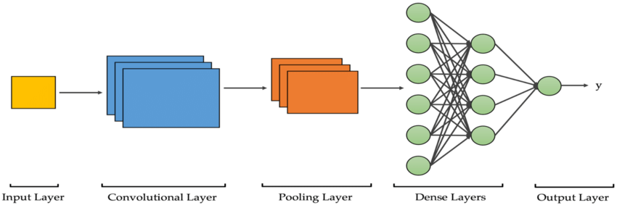
1.2 CNN
Convolutional Neural Networks (CNNs) are a powerful tool for machine learning, especially in tasks related to computer vision. Convolutional Neural Networks, or CNNs, are a specialized class of neural networks designed to effectively process grid-like data, such as images.
Input Layer: Receives the raw image data as input.
Convolutional Layer: extract feature maps, highlighting various features such as edges, textures, and patterns.
Pooling Layer: Reduces the spatial dimensions (width and height) of the feature maps.
Dense Layer: connects every neuron from the previous layer to every neuron in the next layer.
Output Layer: Converts the final fully connected layer's outputs into the desired format (e.g., class probabilities for classification)

Slide 7
Tools
TOOLS
Python
Jupyter lab
CNN
CPU & GPU
CPU
arithmetic
logical functions
I/O operations.
GPU,
accelerated calculations
render intensive high-resolution images and graphics
rendering 2D and 3D images,
videos
animation
considered the top player in the world data science thanks
ease of use
clarity
robust library and framework support
Its an open-source web platform
create and share documents
live code
data visualization
data cleaning and transformation
machine learning (ML), numerical simulation, and statistical modeling.
A type of deep learning model designed for processing structured grid data, primarily used for image recognition and processing.
Object Detection
Image Classification

Slide 8
Methods
The methodology involves several key steps:
Environment Setup :
- Verified CPU and GPU configurations
- Installed necessary dependencies (TensorFlow, OpenCV, Matplotlib)
Data Preprocessing :
- Loaded and preprocessed image data
- Split into training, validation, and test sets
Model Building : Constructing a convolutional neural network (CNN) using TensorFlow's Keras API,
with layers including convolutional layers, max-pooling layers, dense layers, and dropout layers.
- Layers: Conv2D, MaxPooling2D, Dense, Flatten, Dropout
Training the model : Training the model on the prepared dataset, with performance monitored using TensorBoard callbacks.
- Epochs: 20
- Training accuracy: Reached near-perfect levels
- Validation accuracy: Also reached near-perfect levels
- Performance monitored using TensorBoard callbacks

Slide 9
Methods
Model Evaluation :
Evaluating the model's performance using metrics such as accuracy, Loss precision, and recall.
Model Testing :
Testing the model with new data to assess its generalization capabilities.
Model Saving :
- Saving the trained model for future use.
- Saved the model in HDF5 format

Slide 10
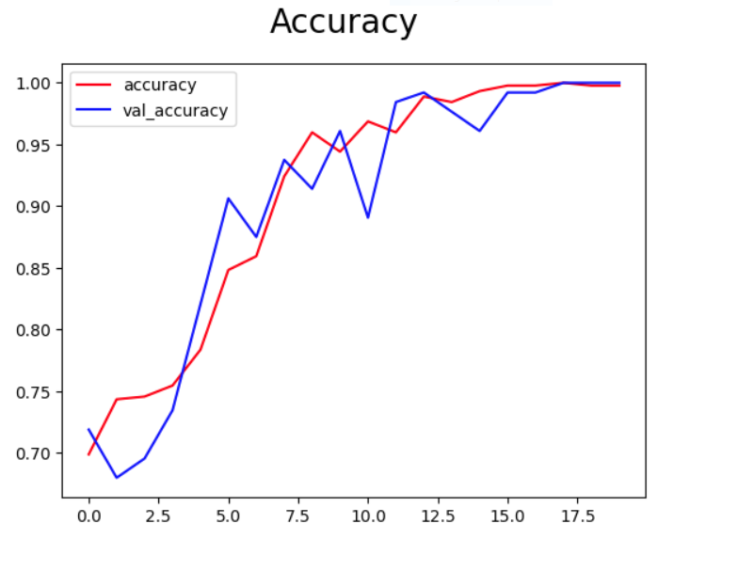
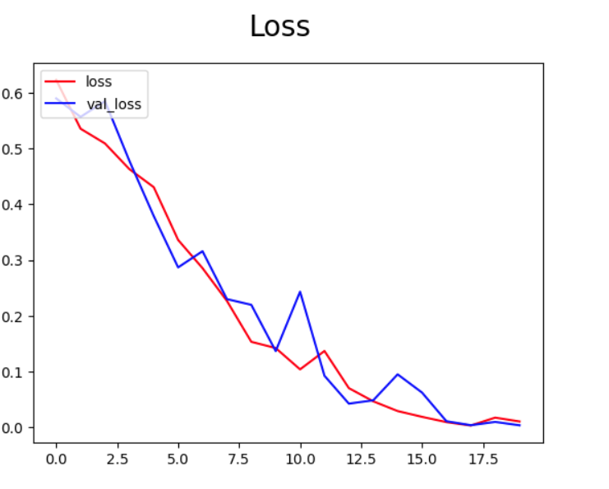
Results
Training accuracy: 0.9997
Validation accuracy: 1.0000
Training loss: 0.0026
Validation loss: 0.0034
The results include:-
Model Performance : The model achieved high accuracy in classifying images of kittens and puppies, with training and validation accuracy reaching near-perfect levels.
Tested with new data
Predicted class for 'cutie_puppie.jpeg': Puppies
Confidence level: 0.9999996
Loss and Accuracy Plots : Visualizations of the model's training and validation loss and accuracy over epochs, indicating a stable and effective learning process.

Slide 11
Results
Loss
Accuracy
Definition: Loss is a measure of how well or poorly a model's predictions match the actual target values. It quantifies the difference between the predicted outputs and the true values.
Purpose: During training, the goal is to minimize the loss function. Lower loss indicates that the model's predictions are closer to the actual values.
Validation Loss
Definition: Validation loss is the loss calculated on the validation set, a subset of the data not used for training. It measures how well the model's predictions match the actual target values in the validation set.
Purpose: Monitoring validation loss helps detect overfitting. If validation loss starts to increase while training loss decreases, the model might be overfitting the training data.
Definition: Accuracy is the ratio of correctly predicted instances to the total instances. It is a measure of how many predictions a model got right.
Purpose: It provides an overall measure of the model's performance in terms of it’s ability to correctly classify instances.
Validation Accuracy
Definition: Validation accuracy is the ratio of correctly predicted instances to the total instances in the validation set. It indicates how accurately the model performs on the validation data.
Purpose: Validation accuracy provides an estimate of the model's performance on unseen data, helping to ensure that the model is not just memorizing the training data but is generalizing well to new data.

Slide 12
Results
Model Evaluation : The model demonstrated strong performance on the test set, with perfect precision, recall, and accuracy.
Results:
Precision: Precision is defined as the ratio of correctly classified positive samples (True Positive) to a total number of classified positive samples
(either correctly or incorrectly).
Precision = True Positive/True Positive + False Positive
- precision for our model is 1.0
b. Recall: The recall is calculated as the ratio between the numbers of Positive samples correctly classified as Positive to the total number of Positive samples. The
recall measures the model's ability to detect positive samples. The higher the recall, the more positive samples detected.
Recall = True Positive/True Positive + False Negative
- Recall for our model is 1.0
Accuracy: Accuracy is a metric that measures how often a machine learning model correctly predicts the outcome.
Accuracy = Correct Predictions/All Predictions
- Accuracy for our model is 1.0

Slide 13
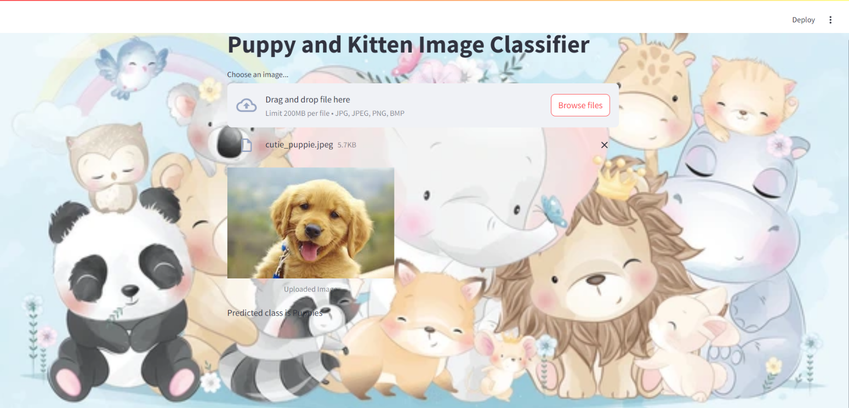
Results
Model Usage : The saved model was successfully loaded and used to classify new images, maintaining high accuracy
Saved the model in HDF5 format
Loaded and tested the saved model
Predicted class for 'cutie_puppie.jpeg': Puppies

Slide 14
Conclusion
Model successfully built and trained
Achieved high accuracy in classifying kittens and puppies
Model ready for future use

Slide 15
References
https://www.geeksforgeeks.org/introduction-convolution-neural-network/
https://www.javatpoint.com/gpu-vs-cpu
https://docs.streamlit.io/develop/concepts
https://www.youtube.com/watch?v=jztwpsIzEGc

